Slide 1

Long Short-Term Memory for time series

Slide 2
Objectives
Understand the Long Short-Term Memory for time series
Implement multi-layer LSTM for forecasting
Long Short-Term Memory for time series

Slide 3
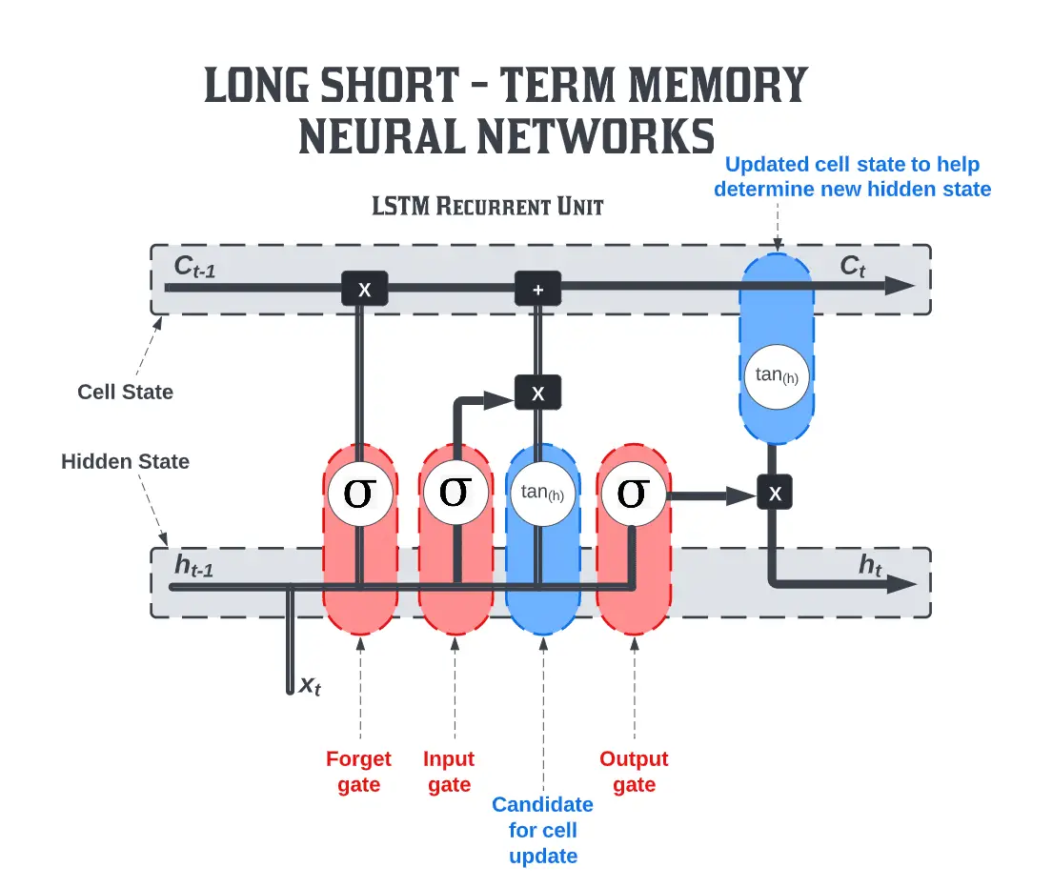
Long Short-Term Memory
Long Short-Term Memory (LSTM) is a type of recurrent neural network (RNN) architecture designed to address the limitations of traditional RNNs, specifically the vanishing gradient problem.
Long Short-Term Memory for time series

Slide 4
Features of LSTM networks:
Memory Cells:
  LSTMs introduce memory cells that can store information for long periods, allowing the network to capture dependencies over extended sequences.
Cell State:
  LSTMs maintain a cell state, which serves as a long-term memory storage. The cell state is updated through the input gate, forget gate, and output gate.
Backpropagation Through Time (BPTT):
  LSTMs use Backpropagation Through Time (BPTT) during training to update the model's parameters based on the error gradients.
Long Short-Term Memory for time series

Slide 5
Features of LSTM networks:
Gating Mechanisms:
  LSTMs incorporate gating mechanisms to control the flow of information through the network. These mechanisms include the input gate, forget gate, and output gate.
  Input Gate: Regulates the amount of new information to be stored in the memory cell.
  Forget Gate: Determines what information from the memory cell should be discarded or forgotten.
  Output Gate: Controls the information that is passed to the next time step.
Long Short-Term Memory for time series

Slide 6
Features of LSTM networks:
Addressing Vanishing Gradient:
  The architecture of LSTMs enables them to mitigate the vanishing gradient problem, which is a common issue in traditional RNNs. The gating mechanisms allow LSTMs to selectively update and retain information over long sequences.
Flexibility in Sequence Length:
  LSTMs can handle sequences of varying lengths, making them suitable for tasks where the length of the input or output sequence is not fixed.
Long Short-Term Memory for time series

Slide 7
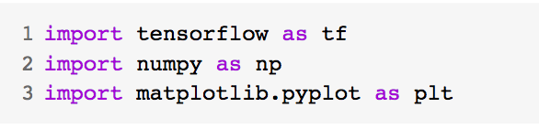
Implement multi-layer LSTM for forecasting
Imports libs
  Tensorflow to build your model and prepare data windows
  Numpy for numerical processing
  Matplotlib's PyPlot library for visualization
Recurrent Neural Networks for time series

Slide 8
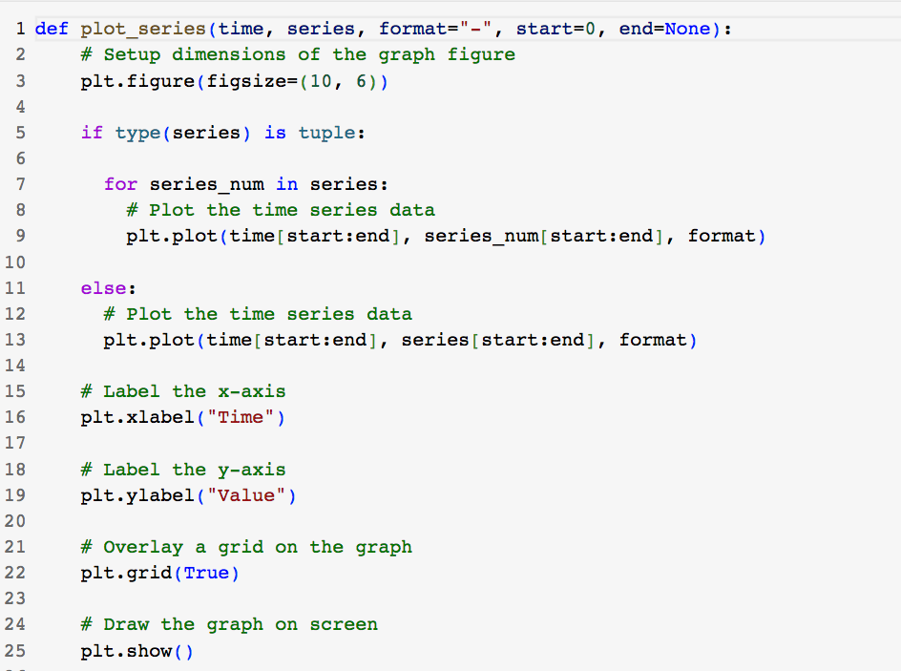
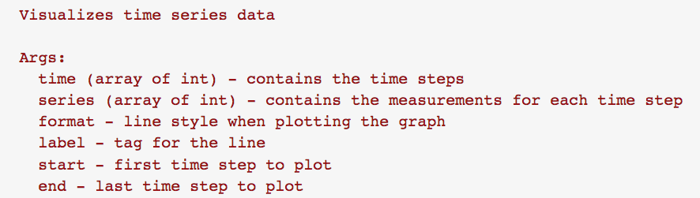
Implement multi-layer LSTM for forecasting
Utilities
Recurrent Neural Networks for time series

Slide 9
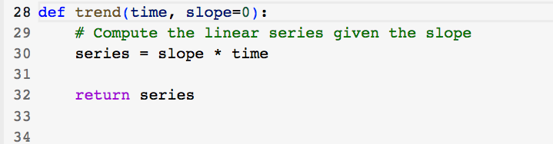
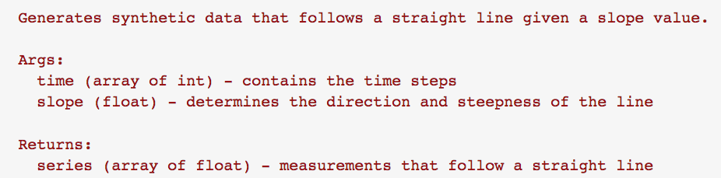
Implement multi-layer LSTM for forecasting
Utilities
Recurrent Neural Networks for time series

Slide 10
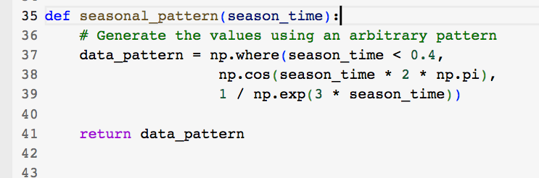
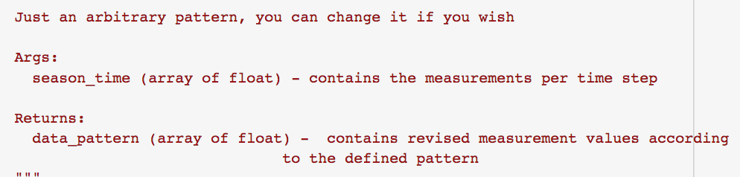
Implement multi-layer LSTM for forecasting
Utilities
Recurrent Neural Networks for time series

Slide 11
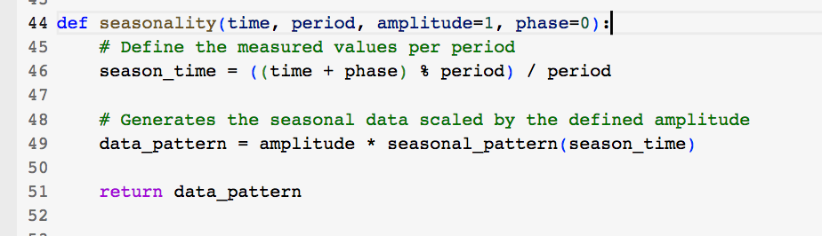
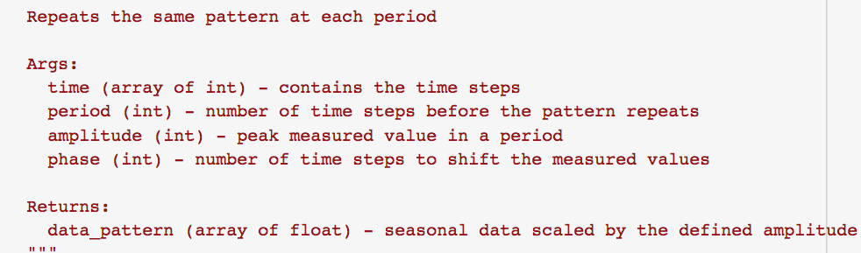
Implement multi-layer LSTM for forecasting
Utilities
Recurrent Neural Networks for time series

Slide 12
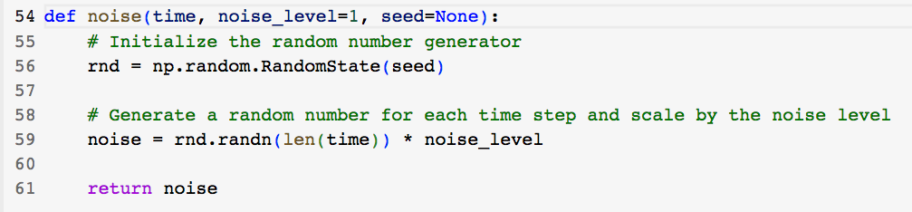
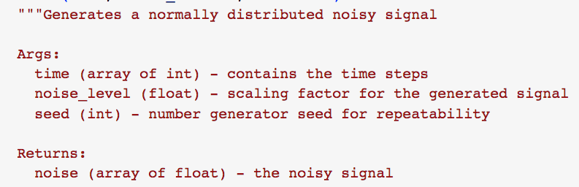
Implement multi-layer LSTM for forecasting
Utilities
Recurrent Neural Networks for time series

Slide 13
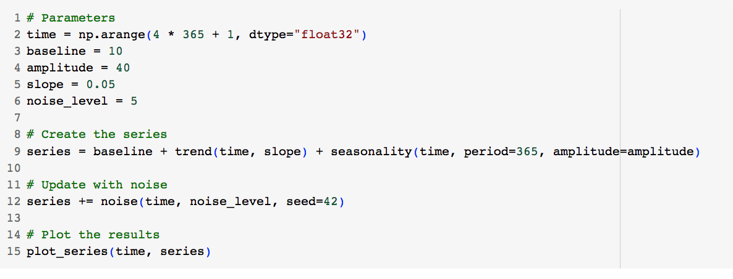
Implement multi-layer LSTM for forecasting
Generate the Synthetic Data
Recurrent Neural Networks for time series

Slide 14
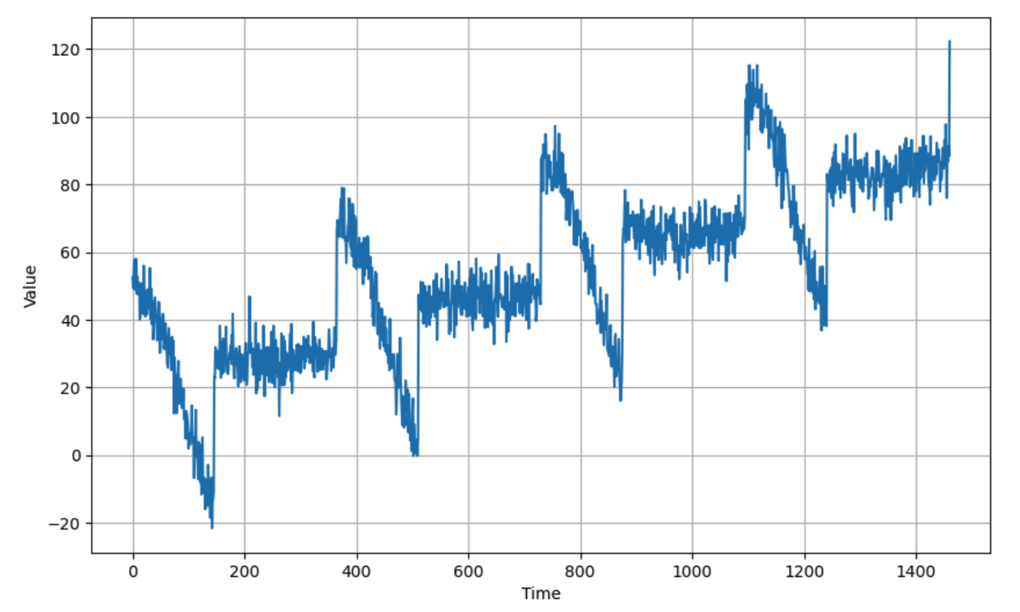
Implement multi-layer LSTM for forecasting
Generate the Synthetic Data
Recurrent Neural Networks for time series

Slide 15
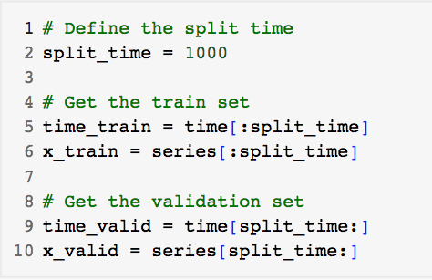
Implement multi-layer LSTM for forecasting
Split the Dataset
Recurrent Neural Networks for time series

Slide 16
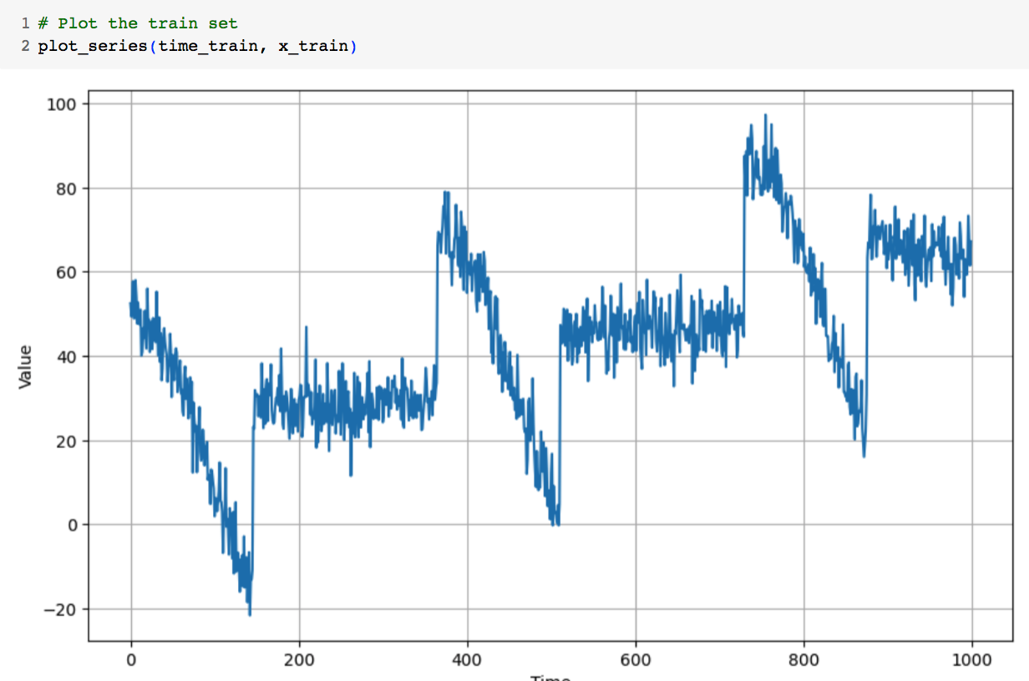
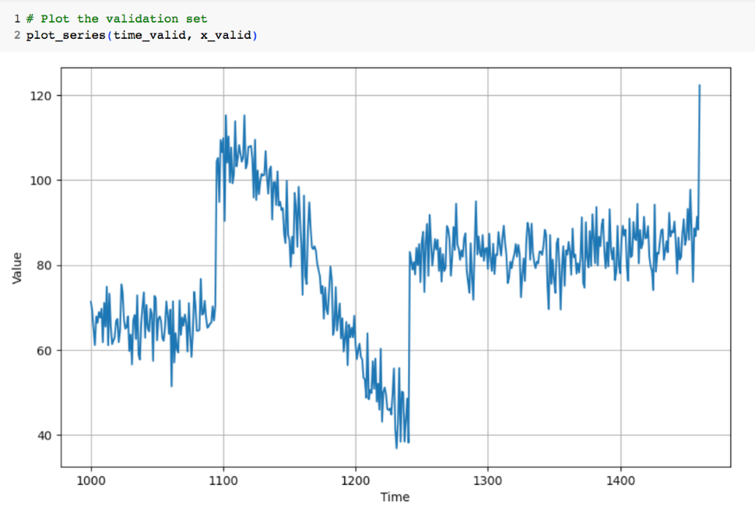
Implement multi-layer LSTM for forecasting
Train and validation set
Recurrent Neural Networks for time series

Slide 17
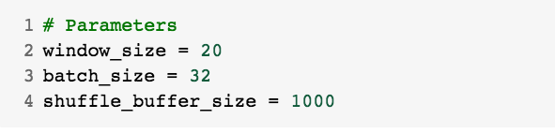
Implement multi-layer LSTM for forecasting
Prepare features and labels
Recurrent Neural Networks for time series

Slide 18
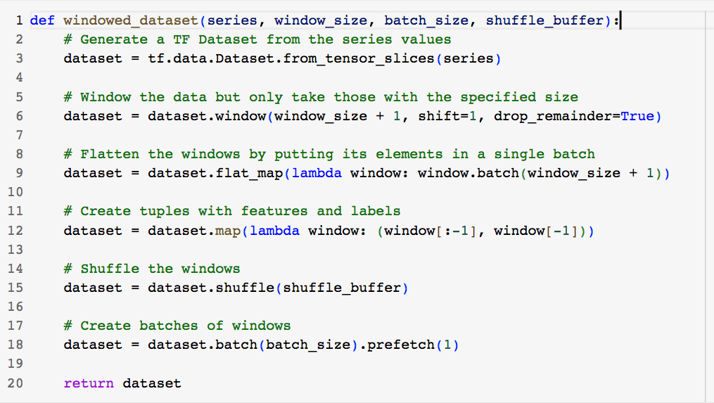
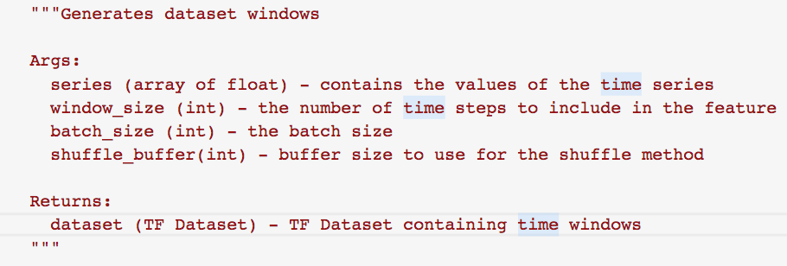
Implement multi-layer LSTM for forecasting
Generates dataset windows
Recurrent Neural Networks for time series

Slide 19
Implement multi-layer LSTM for forecasting
Generate the dataset windows from the train set.
Recurrent Neural Networks for time series

Slide 20
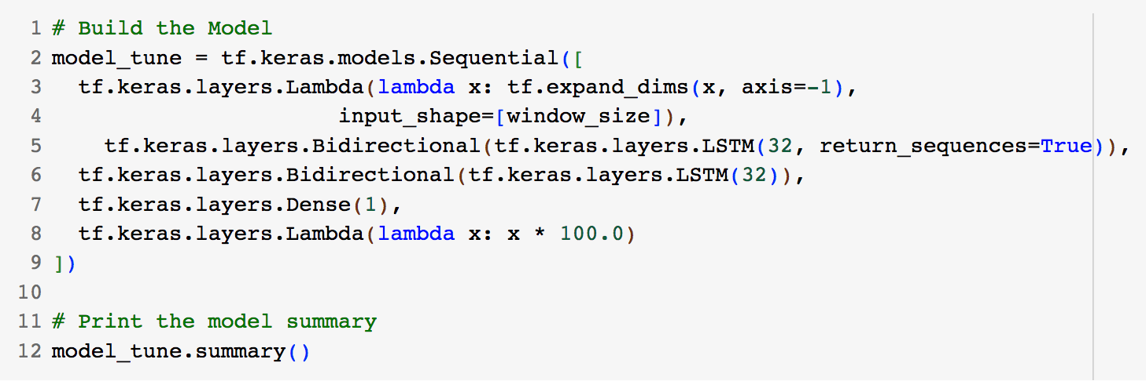
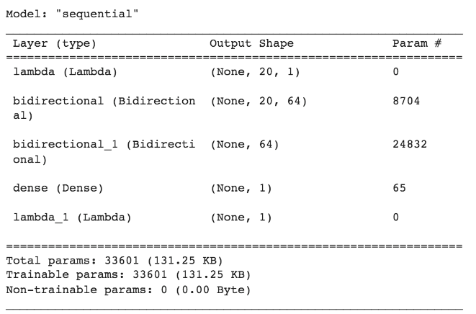
Implement multi-layer LSTM for forecasting
Build the Model
Long Short-Term Memory for time series

Slide 21
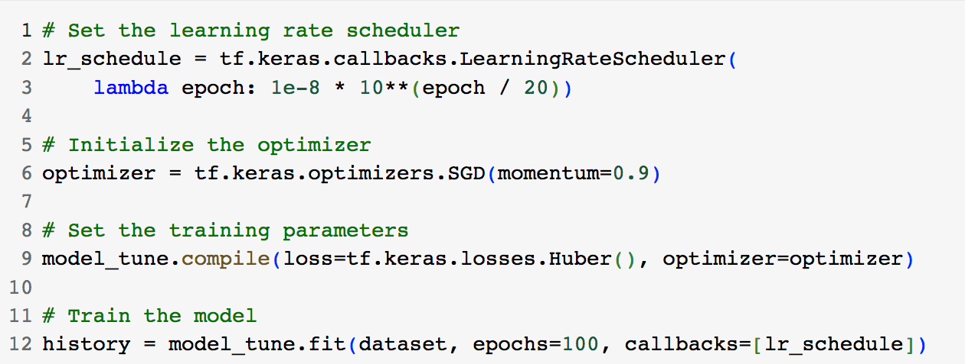
Implement multi-layer LSTM for forecasting
Setup and training
Long Short-Term Memory for time series

Slide 22
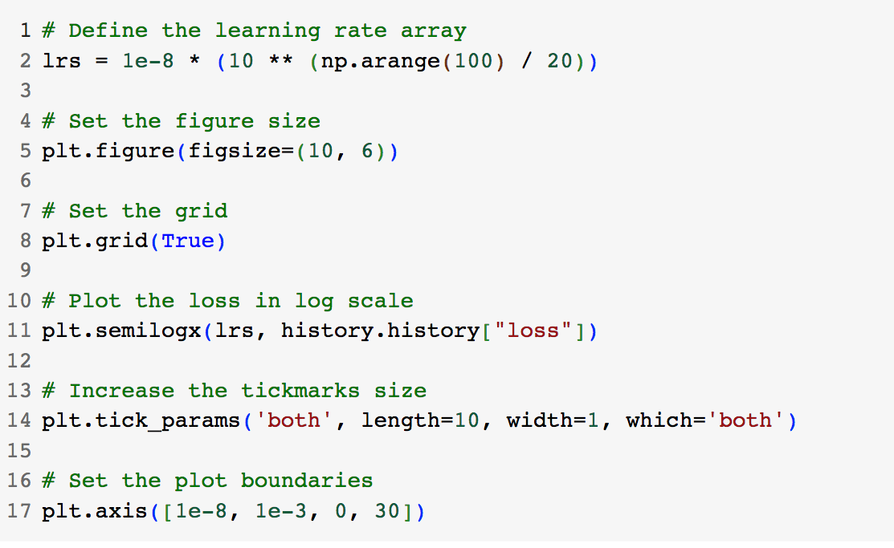
Implement multi-layer LSTM for forecasting
Tune the Learning Rate: optimize
Long Short-Term Memory for time series

Slide 23
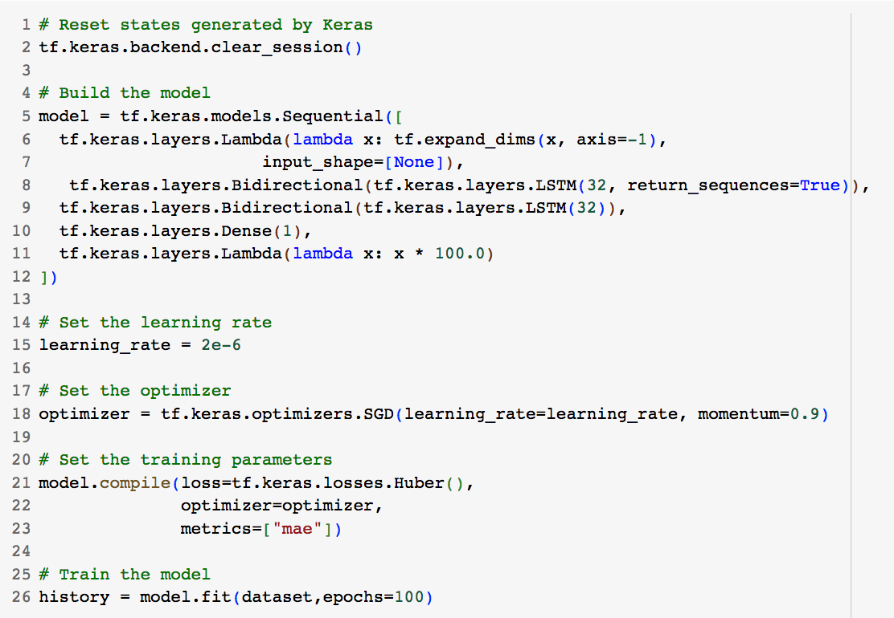
Implement multi-layer LSTM for forecasting
Rebuild the Model
Long Short-Term Memory for time series

Slide 24
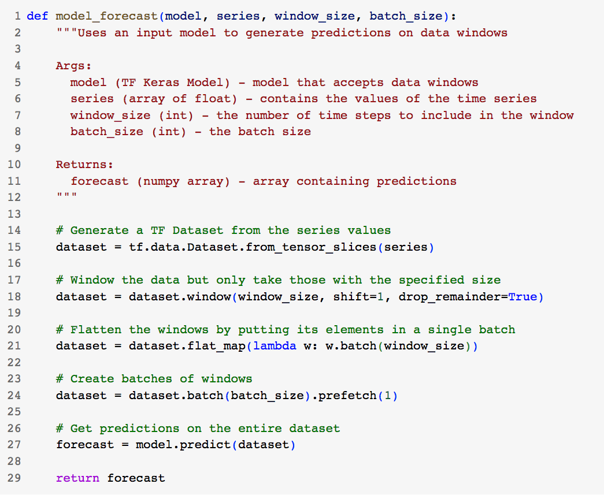
Implement multi-layer LSTM for forecasting
Model Prediction
Long Short-Term Memory for time series

Slide 25
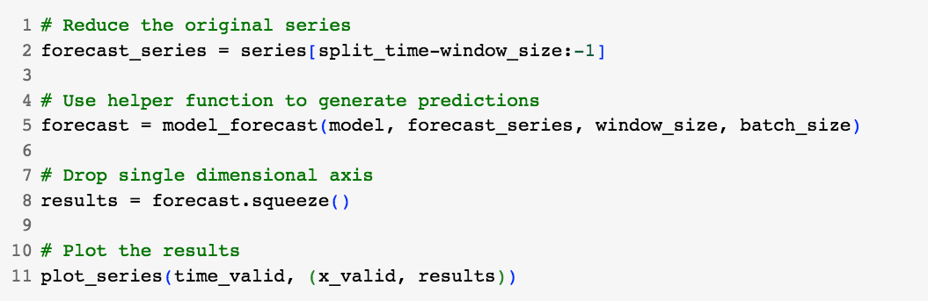
Implement multi-layer LSTM for forecasting
Model Prediction
Long Short-Term Memory for time series

Slide 26
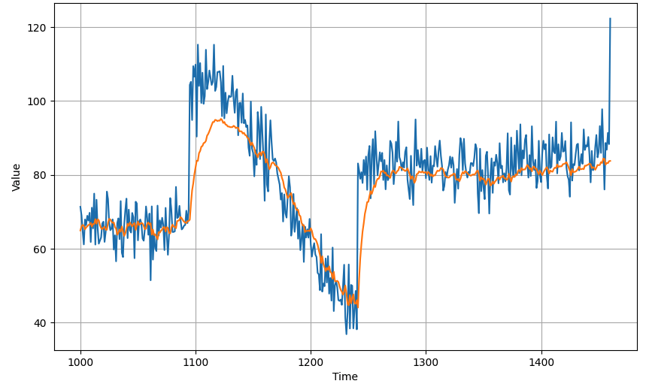
Implement multi-layer LSTM for forecasting
Model Prediction
Long Short-Term Memory for time series

Slide 27
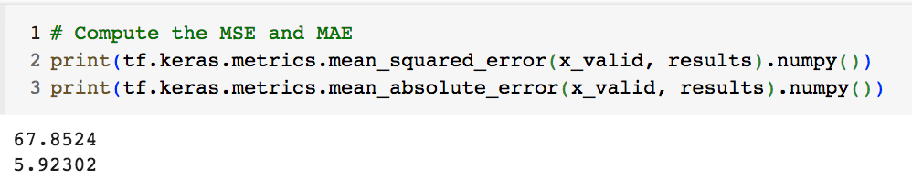
Implement multi-layer LSTM for forecasting
Generate the metrics to evaluate the model's performance.
Long Short-Term Memory for time series

Slide 28
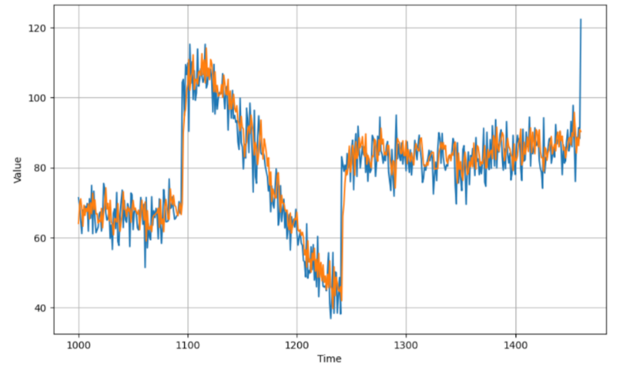
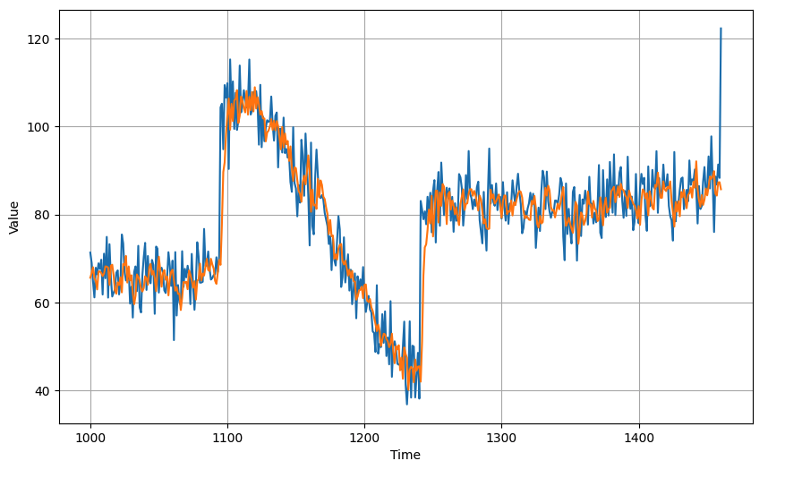
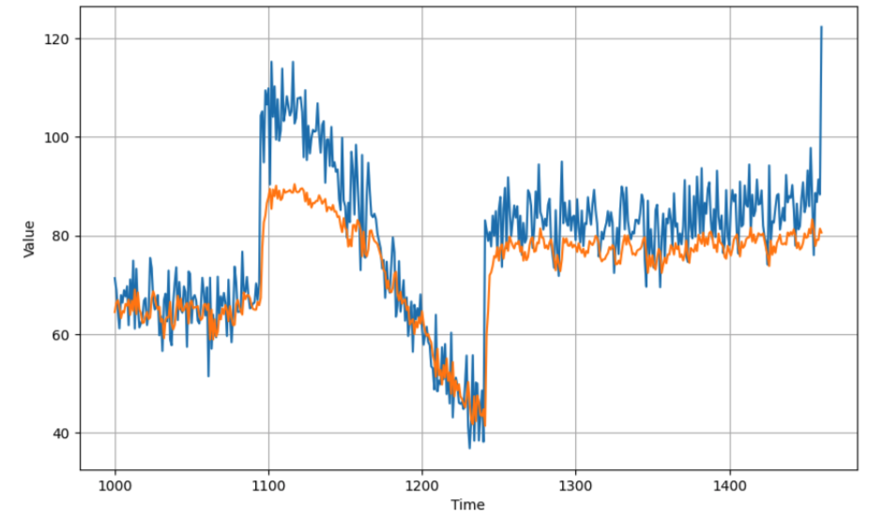
Student discuss and give opinions
SNN
DNN
RNN
LSTM
Long Short-Term Memory for time series

Slide 29
Summary
Understand the Long Short-Term Memory for time series
Implement multi-layer LSTM for forecasting
Long Short-Term Memory for time series

Slide 30
Q & A
Long Short-Term Memory for time series

